Slide 1




Research Presentation
Made by Dev Parikh
Literature Review: AI Chatbots in the Legal Field

Slide 2
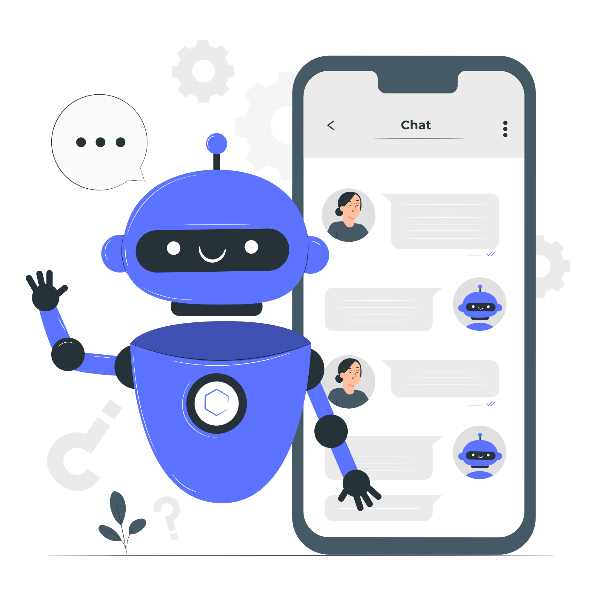
Introduction
This integration of AI chatbots into the legal profession has far-reaching repercussions.
AI chatbots are specifically created to perform activities including automated document processing, legal research and giving legal advice. [1]

Slide 3
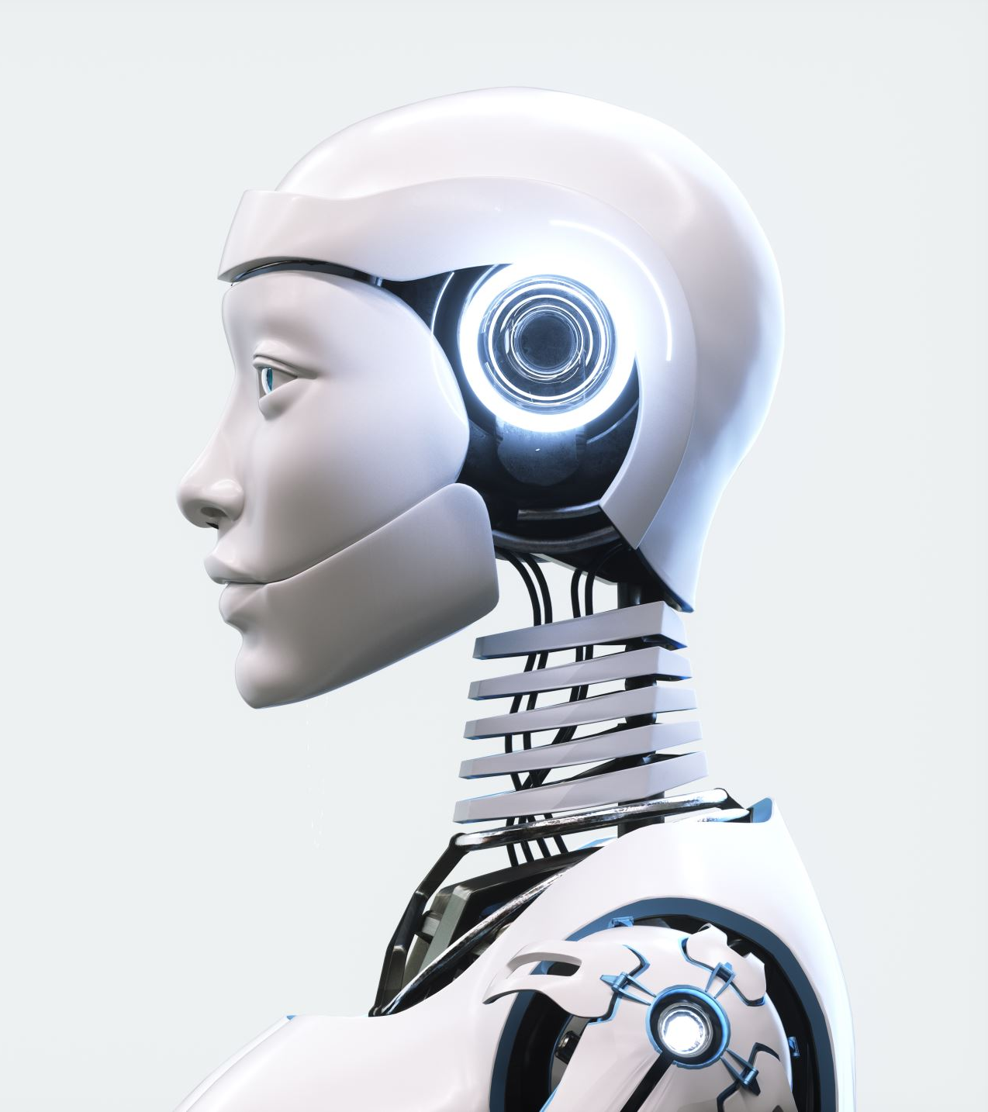
Legal AI Chatbots Capabilities and Benefits
1. AI chatbots provide a user-friendly interface for individuals seeking legal guidance, enhancing access to legal information.[1]
2. They contribute to efficiency by allowing lawyers to focus on more complex legal work, thereby saving time and reducing operational costs. [1]

Slide 4

Challenges and Verification in Legal Research
1. Concerns exist about the reliability of AI chatbots for legal research, as many purport to contain legal doctrines or conclusions without providing supporting citations.[3]
2. Lawyers cannot rely solely on the results provided by AI chatbots without independent verification.[3]

Slide 5

Ethical and Regulatory Considerations
The use of AI chatbots in legal services raises ethical and regulatory issues, such as the unauthorized practice of law and the need for clear guidelines on the use of AI-generated content.[4]

Slide 6
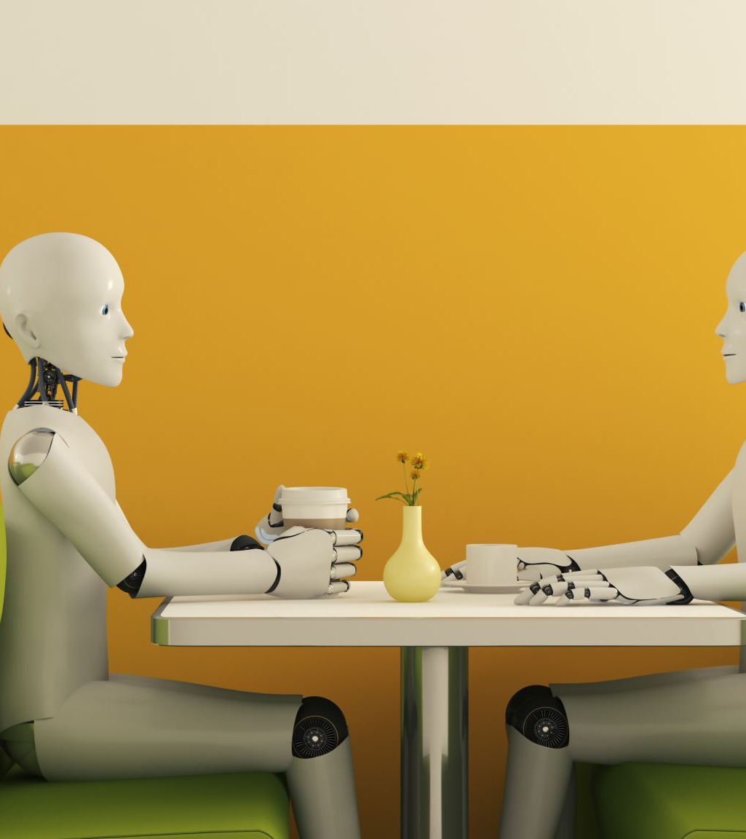
Future of AI Chatbots in Legal Authorship
The question of whether AI chatbots can be considered authors of academic papers is discussed, with implications for copyright law and scholarly authorship.[2]

Slide 7

Conclusion
AI chatbots are poised to transform the legal profession by providing efficient legal research and support. However, their use is accompanied by significant challenges, including the need for verification of legal information, ethical concerns, and regulatory issues.

Slide 8

Link to Research Papers
1. Can an artificial intelligence chatbot be the author of a scholarly article?
Source: PubMed Central (PMC)
Link: Can an artificial intelligence chatbot be the author of a scholarly article?
2. Service chatbot: Co-citation and big data analysis toward a review
Source: ScienceDirect
Link: Service chatbot: Co-citation and big data analysis toward a review
3. Development of a Legal Document AI-Chatbot
Source: arXiv
Link: Development of a Legal Document AI-Chatbot
4. LAW-U is an Artificial Intelligence (AI) chatbot that gives legal guidance to survivors of sexual violence by recommending the most relevant
Source: IEEE Xplore
Link: LAW-U is an Artificial Intelligence (AI) chatbot that gives legal guidance to survivors of sexual violence by recommending the most relevant

Slide 9
Research Presentation End
Notes:
You can use this slide as your opening or closing slide. Should you choose to use it as a closing, make sure you review the main points of your presentation. One creative way to do that is by adding animations to the various graphics on a slide. This slide has 4 different graphics, and, when you view the slideshow, you will see that you can click to reveal the next graphic. Similarly, as you review the main topics in your presentation, you may want each point to show up when you are addressing that topic.
Add animation to images and graphics:
Select your image or graphic.
Click on the Animations tab.
Choose from the options. The animation for this slide is “Split”. The drop-down menu in the Animation section gives even more animations you can use.
If you have multiple graphics or images, you will see a number appear next to it that notes the order of the animations.
Note: You will want to choose the animations carefully. You do not want to make your audience dizzy from your presentation.

